Slide 1

Mesh Analysis Course Tutor: MS. Israt Sultana Dept. of CSE Course Title : Electrical Circuit Course code : CSE-133
Welcome
To Our Presentation
Team 1

Slide 2


Slide 3
Table of Contents
1. Introduction to Mesh.
2. Steps of Mesh analysis.
3. Application of mesh analysis.
4. Mesh Vs Nodal Analysis.
5. Understanding and intro to Super-mesh.
6. Properties and Application of Super-mesh.

Slide 4
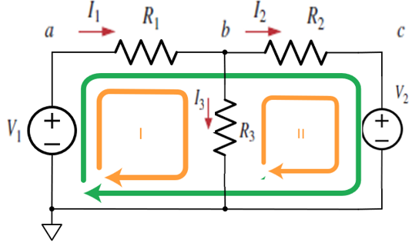
Definition:
Mesh is a loop that does not contain any
loop within it.
Mesh analysis apply KVL to find unknown
currents. it is only applicable to planner
circuit( a circuit that can be drawn on a
plane with no branch crossing each other).
Fig: Mesh Analysis

Slide 5
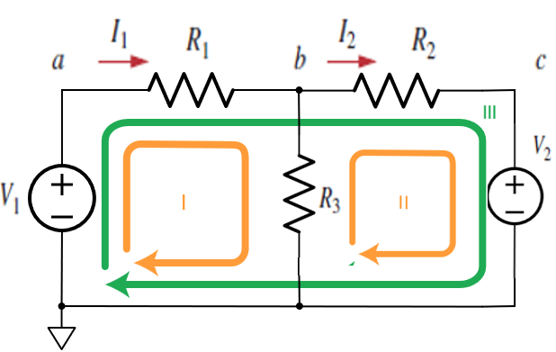
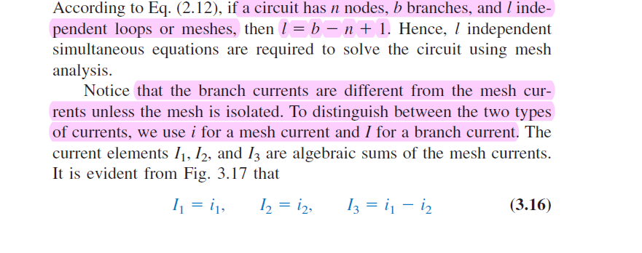
Steps of Mesh Analysis:
1. Identify the number of basic meshes. assignment current i1, i2, i3 ..... in.
2. Apply KVL to each of the n meshes and use Ohm's law to express the voltage in terms of mesh current.
3. Solve the n resulting Linear Equations to find the mesh currents.

Slide 6
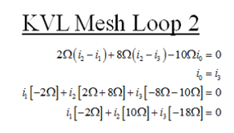
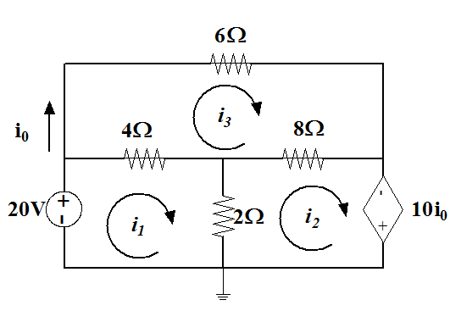
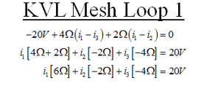
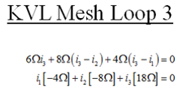
Application of Mesh Analysis
Using calculator:
i1 = -3.21
i2 = -9.64
i3 = -5

Slide 7
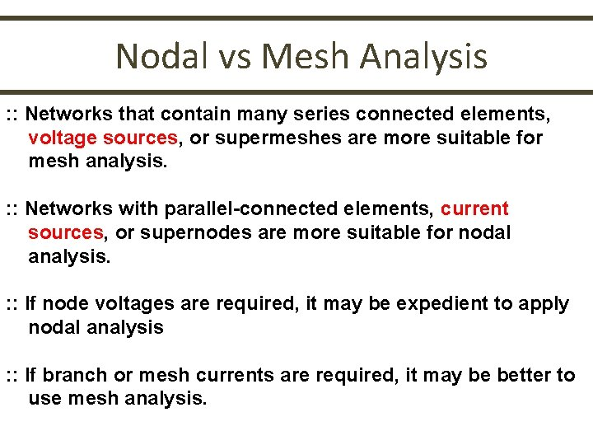
Mesh Vs Nodal Analysis

Slide 8
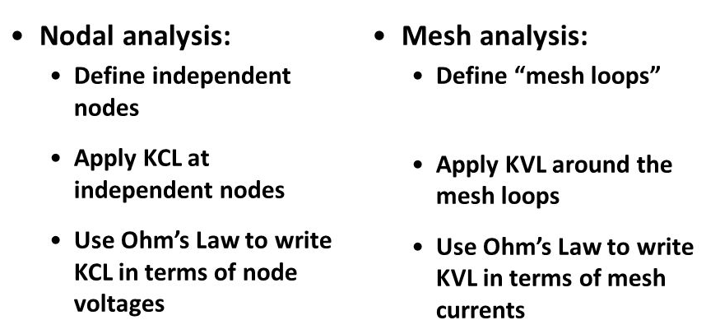
Mesh & Nodal Comparison

Slide 9
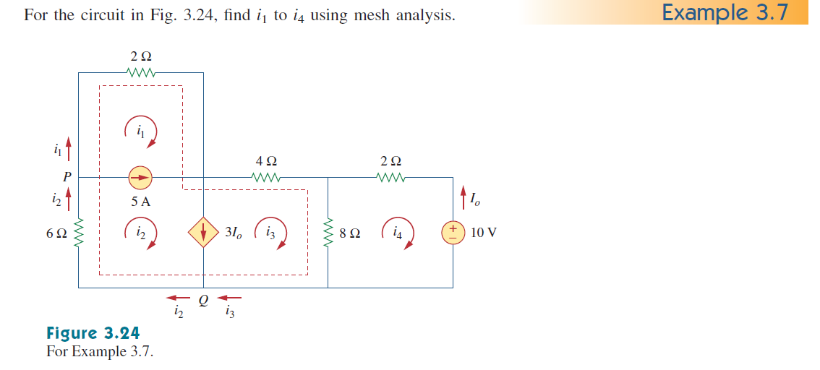
Super-mesh:
A current source exist between two contiguous meshes, the two meshes collapsed into a single mesh called a super-mesh.
The current source and any elements connected in series with it removed. However, KVL must still be satisfied within is super-mesh using the old match current labels. also the removal of provides another mesh equation.
Fig: Super-mesh

Slide 10
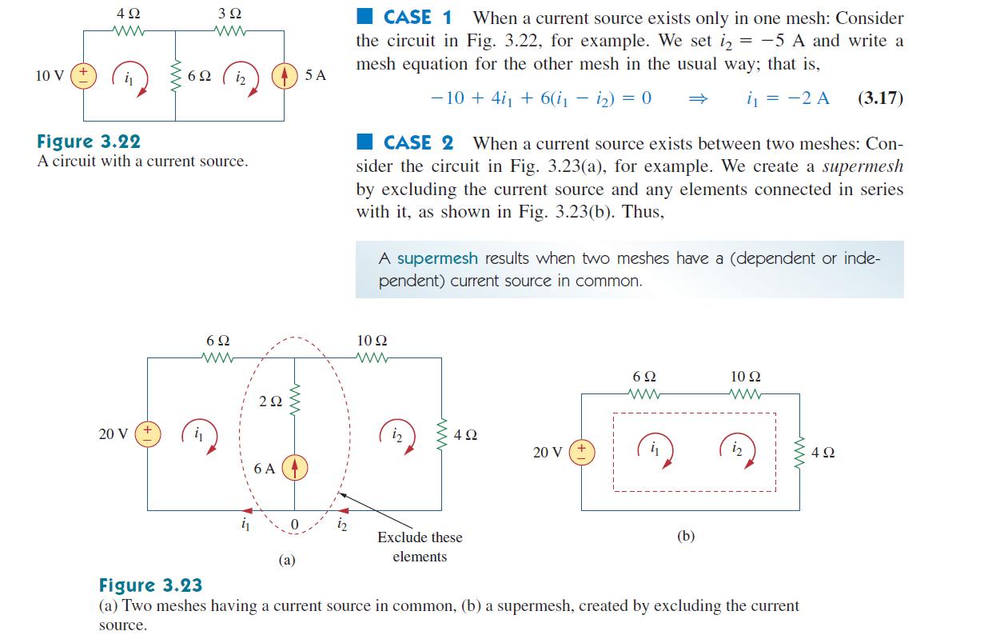
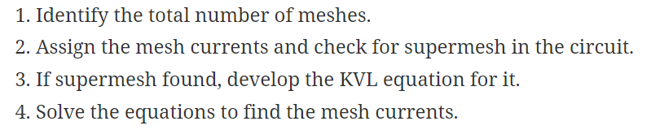
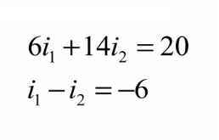
Properties of A Super-mesh:

Slide 11
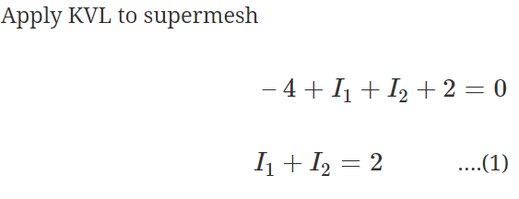
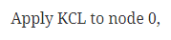
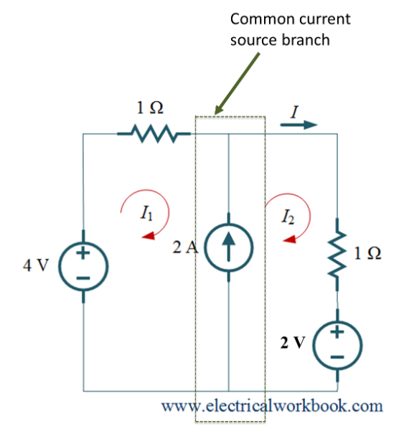
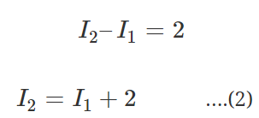
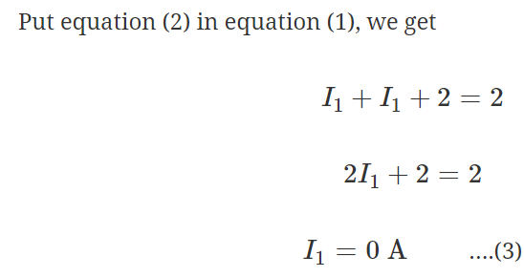
Applications of A Super-mesh:

Slide 12
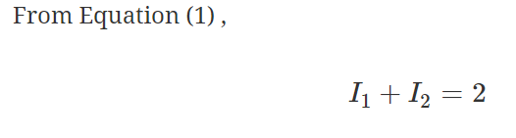
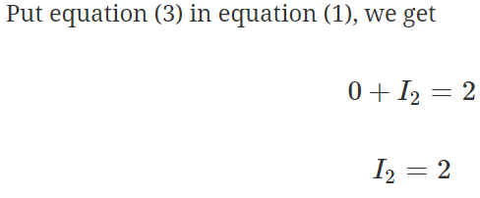
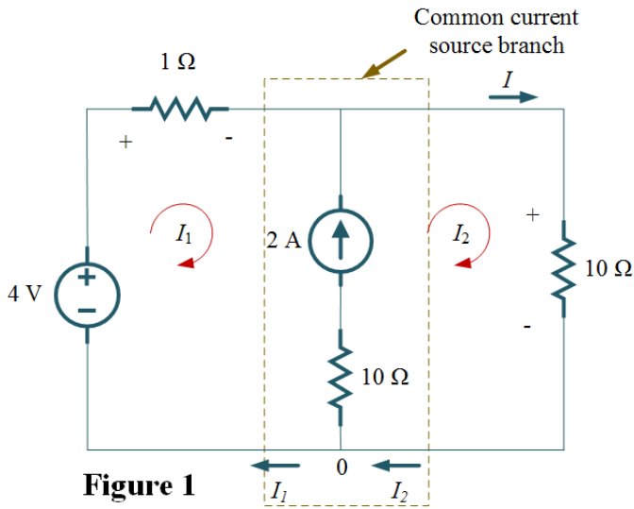
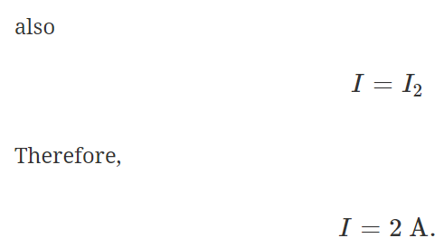
Applications of A Super-mesh:

Slide 13


